Slide 1
P,NP and NP complete problems
Final Chapter

Slide 2
Types Problems
There are various kinds of computational problems

Slide 3

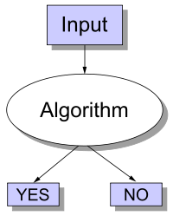
Decision Problems
Problems where the answer is either YES or NO

Slide 4
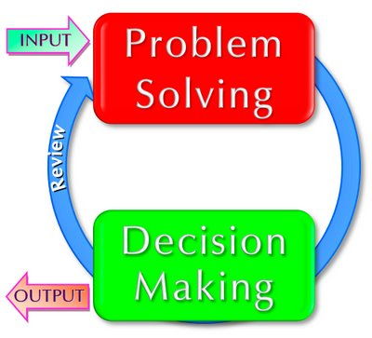
Decision Problems
Problems where the answer is either YES or NO
This simplifies notation and allows us to write
x∈Q in place of Q(x)=YES
and x∉Q in place of Q(x)=NO.

Slide 5
Decision Problem: Examples
Decision problem:
Input: a natural number x,
Question: is x an even number?
Membership Problem:
Input: a natural number x,
Question: is x in Even={0,2,4,6,⋯}?
We refer to the YES answer on an input as accepting the input
and to the NO answer on an input as rejecting the input.

Slide 6
P class Definition
The class of polynomially solvable problems, P contains all sets in which membership may be decided by an algorithm whose running time is bounded by a polynomial.

Slide 7
P class problems
Problems with Efficient Algorithms for Finding Solutions
Efficient algorithms:
algorithms that use at most polynomial amount of computational resources
algorithms that have polynomial worst-case running time
P is the class of decision problems that can be solved efficiently
decision problems which have polynomial-time algorithms.

Slide 8
P class problem
a decision problem Q is in P iff there is an efficient algorithm A such that for all inputs x,
if Q(x)=YES then A(x)=YES,
if Q(x)=NO then A(x)=NO.
Searching of key elements
Sorting of elements
All pairs shortest path

Slide 9
Examples
Finding the killer (the solution) is incredibly hard for the detective. But once the killer confesses and shows exactly how they did it (the certificate/proof), the jury can verify the story matches the evidence very quickly.
Solving a 16x16 Sudoku from scratch is hard and takes a long time. But if I give you a completed board, you can check if it's correct almost instantly by just scanning the rows and columns.
Factoring a massive number into primes

Slide 10
NP class Problems
Problems with Efficient Algorithms for Verifying Proofs/Certificates/Witnesses
decision problems for which we do not know any efficient way of finding the answer
however if answer is provided with a proof, we can efficiently verify that the answer is correct or not by checking the proof .

Slide 11
NP class Definition
The class of nondeterministic polynomially acceptable problems, NP, contains all sets in which membership can be verified in polynomial time.

Slide 12
NP
NP is not the same as non-polynomial complexity/running time. NP does not stand for not polynomial.
NP = Non-Deterministic polynomial time
NP means verifiable in polynomial time
Verifiable?
If we are somehow given a ‘certificate’ of a solution we can verify the legitimacy in polynomial time

Slide 13
NP problems
Graph theory has these fascinating(annoying?) pairs of problems
Shortest path algorithms?
Longest path is NP complete (we’ll define NP complete later)
Eulerian tours (visit every vertex but cover every edge only once, even degree etc). Solvable in polynomial time!
Hamiltonian tours (visit every vertex, no vertices can be repeated). NP complete

Slide 14
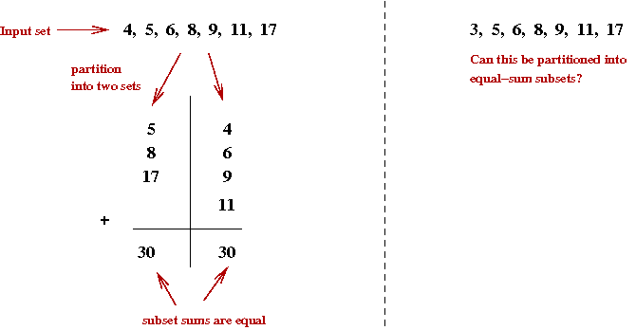
NP class Problems : Example
Partition
Input: a finite set of natural numbers S,
Question: partition S into two sets A and B
A∪B=S & A∩B=∅
such that the sum of the numbers in A is equal to the sum of number in B
(∑x∈Ax=∑x∈Bx)?

Slide 15
Partition Problem: Solution
Given a set S and ask you to partition it into two sets such that their sums are equal
Do you know any efficient algorithm to solve it?
Method : try all possible ways of partitioning the numbers into two sets until you find a partition where the sums are equal
[complexity is exponential]
If any of them worked you would say YES, otherwise you would say NO.

Slide 16
NP: Partition Problem: Example
example: A={2,4} and B={1,5} S={1,2,4,5}
can be partitioned into two sets with equal sums.
We just need to sum up the numbers in A and the numbers in B and see if the results are equal, and check if A, B is partition of S.
If A={2,5} and B={1,4}
The proof is invalid.
It does not mean the answer is NO, it just means that this particular proof was invalid.
Your task here is not to find the answer, but only to check if the proof you are given is valid or not.

Slide 17
NP formal definition
a decision problem Q is in NP iff
there is an efficient algorithm V [verifier] such that for all inputs x,
if Q(x)=YES then there is a proof y such that V(x,y)=YES,
if Q(x)=NO then for all proofs y, V(x,y)=NO.
TSP
Graph coloring problem
Knapsack Problem
Hamiltonian circuit problems

Slide 18
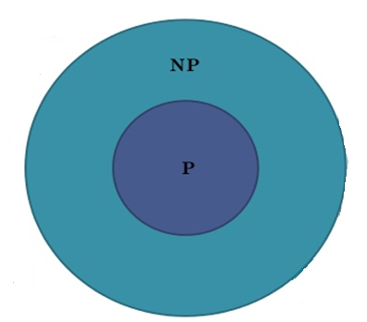
P⊆NP
P=efficient solvable and
NP=efficiently verifiable.
So P=NP iff
any problem in P is also in NP
Is NP = P ?

Slide 19
NP: Example
Input: a list of n +1 natural numbers a1,⋯,an, and s,
Question: is Σn_{i}=s?
The problem is in P because we can sum up the numbers and then compare it with s,
we return YES if they are equal,
and NO if they are not.
The problem is also in NP.
Consider a verifier V that gets a proof plus the input for Sum.
It acts the same way as the algorithm in P that we described above.
This is an efficient verifier for Sum.

Slide 20
Overview of P and NP problems
P denotes the class of computer algorithms which can be executed in a fast way in order to solve a decision or a search problem.
NP corresponds to that problem which can be checked for solution correctness in a fast way whenever a solution is provided.

Slide 21
What is not in NP?
Undecidable problems
Given a polynomial with integer coefficients, does it have integer roots
Hilbert’s nth problem
Impossible to check for all the integers
Even a non-deterministic TM has to have a finite number of states!
Tautology
A Boolean formula that is true for all possible assignments
Here just one ‘verifier’ will not work. You have to try all possible values

Slide 22
Amusing analogy
Students believe that every problem assigned to them is NP-complete in diﬃculty level, as they have to ﬁnd the solutions.
Teaching Assistants, on the other hand, ﬁnd that their job is only as hard as NP, as they only have to verify the student’s answers.
When some students confound the TAs, even veriﬁcation becomes hard

Slide 23
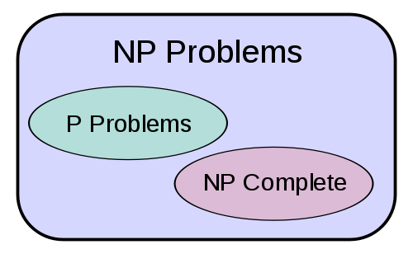
P Vs NP

Slide 24
The Problem P Vs NP
The P vs. NP problem asks whether every problem whose solution can be quickly verified by a computer can also be quickly solved by a computer.
P problems are easily solved by computers
NP problems are not easily solvable

Slide 25
P != NP?
It currently appears that P ≠ NP.
we have plenty of examples of problems that we can quickly verify potential answers to, but that we can’t solve quickly.
But is NP a subset of P?
No one knows if P = NP or not
Solve for a million dollars!
http://www.claymath.org/millennium-problems

Slide 26
Examples : P != NP
A traveling salesman wants to visit 100 different cities by driving, starting and ending his trip at home. He has a limited supply of gasoline, so he can only drive a total of 10,000 kilometers. He wants to know if he can visit all of the cities without running out of gasoline.

Slide 27
Examples : P != NP
A farmer wants to take 100 watermelons of different masses to the market. She needs to pack the watermelons into boxes. Each box can only hold 20 kilograms without breaking. The farmer needs to know if 10 boxes will be enough for her to carry all 100 watermelons to market.

Slide 28
NP: some more examples
Consider final examination scheduling.
A school has n courses and 5 days in which to schedule examinations.
An optimal schedule would be one where no student has to take two examinations on the same day.
This seems like an easy problem.
But there are O(5^{n}) possible different schedules.

Slide 29
Example cont.…
If we check them with a computer which could check a million schedules every second, the time spent checking for a value of n = 50 would be about
Any guesses?
200,000,000,000,000,000,000 years!

Slide 30
Summary
P vs. NP deals with the gap between computers being able to quickly solve problems vs. just being able to test proposed solutions for correctness.
As such, the P vs. NP problem is the search for a way to solve problems that require the trying of millions, billions, or trillions of combinations without actually having to try each one.
Solving this problem would have profound effects on computing, and therefore on our society.

Slide 31
NP complete problems
NP-complete means most difficult NP problems
if we can solve an NP-complete problem efficiently, we can solve all NP problems efficiently.

Slide 32
NP complete and NP Hard
decision problem A is NP-complete iff
A is in NP, and
for all NP problems B, B in polynomial-time may reducible to A (B≤PmA).
NP-hardness is a way of saying that a problem is difficult.

Slide 33
Take two problems A and B both are NP problems. Reducibility- If we can convert one instance of a problem A into problem B (NP problem) then it means that A is reducible to B. NP-hard-- Now suppose we found that A is reducible to B, then it means that B is at least as hard as A. NP-Complete -- The group of problems which are both in NP and NP-hard are known as NP-Complete problem. Now suppose we have a NP-Complete problem R and it is reducible to Q then Q is at least as hard as R and since R is an NP-hard problem. therefore Q will also be at least NP-hard , it may be NP-complete also.

Slide 34
Computational Complexity Problems
Complexity problems
NP Class
NP Hard
P Class
NP Complete

Slide 35
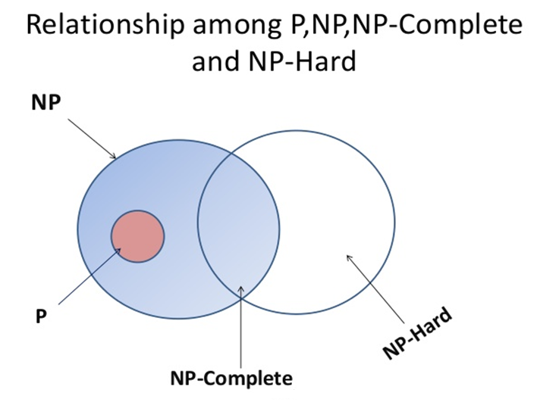

Slide 36
Category | Solvable Quickly? | Verifiable Quickly? | Summary
P | Yes | Yes | Easy
NP | Maybe/Unknown | Yes | Hard to do, easy to check.
NP-Complete | Likely No | Yes | The hardest "easy to check" problems.
NP-Hard | Likely No | Maybe No | The "Boss Level" (often impossible).

Slide 37
When a programmer realizes a problem is NP-Complete, they stop trying to find a "perfect" solution. Instead, they use Heuristics (educated guesses).
Google Maps doesn't actually find the perfect shortest route (NP-Hard/Complete); it finds a "good enough" route very quickly using tricks.
Antivirus Software doesn't check every possible mutation of a virus; it looks for "signatures" because checking every possibility would take years.

